Slide 1
Dynamic Programming:
LCS

Slide 2
Longest Common Subsequence
Given two sequences
  X = ⟨ x₁, x₂, …, x_{m} ⟩
  Y = ⟨ y₁, y₂, …, y_{n} ⟩
A subsequence of a given sequence is just the given sequence with zero or more elements left out.
A common subsequence Z = ⟨ z₁, z₂, …, z_{k} ⟩ of X and Y
  Z is a subsequence of both X and Y
Example:
  X = A B C B D A B
  Y = B D C A B A
Goal: Find the Longest Common Subsequence (LCS)

Slide 3
An Impractical LCS Algorithm
Brute-force algorithm: For every subsequence of x, check if it is a subsequence of y
  How many subsequences of x are there?
  What will be the running time of the brute-force algorithm?
2^{m} subsequences of x to check against n elements of y
  Running time: O(n 2^{m})

Slide 4
Optimal Substructure Property of LCS
The LCS problem has an optimal substructure property
    solutions of subproblems are parts of the final solution
    Subproblems: LCS of pairs of prefixes of X and Y
  An LCS of two sequences contains within it an LCS of prefixes of the two sequences.
Given a sequence X = ⟨ x₁, x₂, …, x_{m} ⟩, we define the ith prefix of X as X_{i} = ⟨ x₁, x₂, …, x_{i} ⟩
Example:
  X = ABCBDABBDCAB
  X₅ = ABCBD
  X₇ = ABCBDAB

Slide 5
Optimal Substructure Property of LCS
Theorem:
Let X = ⟨ x₁, x₂, …, x_{m} ⟩ and Y = ⟨ y₁, y₂, …, y_{n} ⟩ be any sequences, and let Z = ⟨ z₁, z₂, …, z_{k} ⟩ be any LCS of X and Y.
  If x_{m} = y_{n}, then z_{k} = x_{m} = y_{n} and Z_{k – 1} is an LCS of X_{m – 1} and Y_{n – 1}.
  If x_{m} ≠ y_{n}, then z_{k} ≠ x_{m} implies that Z is an LCS of X_{m – 1} and Y.
  If x_{m} ≠ y_{n}, then z_{k} ≠ y_{n} implies that Z is an LCS of X and Y_{n – 1}.
Proof ?
The Theorem tells us that an LCS of two sequences contains within it an LCS of prefixes of the two sequences.
Thus the LCS problem has an optimal substructure property.

Slide 6
Overlapping Subproblem Property of LCS
Theorem:
Let X = ⟨ x₁, x₂, …, x_{m} ⟩ and Y = ⟨ y₁, y₂, …, y_{n} ⟩ be any sequences, and let Z = ⟨ z₁, z₂, …, z_{k} ⟩ be any LCS of X and Y.
  If x_{m} = y_{n}, then z_{k} = x_{m} = y_{n} and Z_{k – 1} is an LCS of X_{m – 1} and Y_{n – 1}.
  If x_{m} ≠ y_{n}, then z_{k} ≠ x_{m} implies that Z is an LCS of X_{m – 1} and Y.
  If x_{m} ≠ y_{n}, then z_{k} ≠ y_{n} implies that Z is an LCS of X and Y_{n – 1}.
The Theorem tells us that
  To find an LCS of X and Y, we may need to find the LCSs of X and Y_{n – 1} and of X_{m – 1} and Y. But each of these subproblems has the subsubproblem of finding an LCS of X_{m – 1} and Y_{n – 1}.
  Thus the LCS problem has the overlapping subproblem property.
The number of distinct subproblems: O(mn).

Slide 7
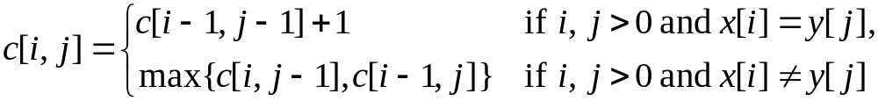
Develop a Recursive Solution
Define c[i, j] to be the length of an LCS of the sequences X_{i} and Y_{j} .
  Goal: Find c[m, n]
  Basis: c[i, j] = 0 if either i = 0 or j = 0
  Recursion: How to define c[i, j] recursively ?
Finding an LCS of X = ⟨ x₁, x₂, …, x_{m} ⟩ and Y = ⟨ y₁, y₂, …, y_{n} ⟩
    If x_{m} = y_{n}, then we must find an LCS of X_{m – 1} and Y_{n – 1}.
    Appending x_{m} = y_{n} to this LCS yields an LCS of X and Y.
  If x_{m} ≠ y_{n}, then we must solve two subproblems:
    Finding an LCS of X_{m – 1} and Y
    Finding an LCS of X and Y_{n – 1}
    Whichever of these two LCSs is longer is an LCS of X and Y.
The recursive formula is

Slide 8
Develop a Recursive Solution
Case 1: x_{i} = y_{j}
  Recursively find LCS of X_{i – 1} and Y_{j – 1} and append x_{i}
  So c[i, j] = c[i – 1, j – 1] + 1 if i, j > 0, and x_{i} = y_{j}
X_{i-1}
x_{i}
equal
Y_{j-1}
y_{j}

Slide 9
Develop a Recursive Solution
Case 2: x_{i} ≠ y_{j}
  Recursively find LCS of X_{i – 1} and Y_{j}
  Recursively find LCS of X_{i} and Y_{j – 1}
  Take the longer one
  So c[i, j] = max{c[i, j – 1], c[i – 1, j]} if i, j > 0, and x_{i} ≠ y_{j}
X_{i-1}
x_{i}
not equal
Y_{j-1}
y_{j}

Slide 10
Dependencies among Subproblems
0
1
j-1
j
n
0
c[i, j] depends on
c[i-1, j-1],
c[i-1, j], and
c[i, j-1]
1
i-1
i
m
Goal
An order for solving the subproblems (i.e., filling in the array) that respects the dependencies is row major order:
  do the rows from top to bottom
  inside each row, go from left to right

Slide 11
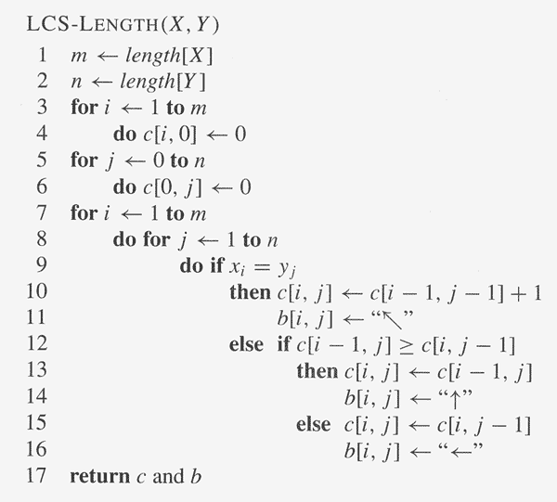
Develop a Recursive Solution
The algorithm calculates the values of each entry of the array c[m, n].
Each c[i, j] is calculated in constant time, and there are m·n elements in the array.
So the running time is O(m·n).

Slide 12
LCS Example
We’ll see how LCS algorithm works on the following example:
X = ABCG
Y = BDCAG
LCS(X, Y) = BCG
X = A B C G
Y = B D C A G

Slide 13
LCS Example
ABCG
BDCAG
j 0 1 2 3 4 5
i
y_{j}
B
D
C
A
G
0
x_{i}
A
1
2
B
3
C
4
G
X = ABCG; m = |X| = 4
Y = BDCAG; n = |Y| = 5
Allocate array: c[5, 4]

Slide 14
LCS Example
ABCG
BDCAG
j 0 1 2 3 4 5
i
y_{j}
B
D
C
A
G
0
x_{i}
0
0
0
0
0
0
A
1
0
2
B
0
3
C
0
4
G
0
for i = 0 to m c[i, 0] = 0
for j = 1 to n c[0, j] = 0

Slide 15
LCS Example
ABCG
BDCAG
j 0 1 2 3 4 5
i
y_{j}
B
D
C
A
G
0
x_{i}
0
0
0
0
0
0
A
1
0
0
2
B
0
3
C
0
4
G
0
if ( x_{i} == y_{j} )
c[i, j] = c[i-1, j-1] + 1
else c[i, j] = max( c[i-1, j], c[i, j-1] )

Slide 16
LCS Example
ABCG
BDCAG
j 0 1 2 3 4 5
i
y_{j}
B
D
C
A
G
0
x_{i}
0
0
0
0
0
0
A
1
0
0
0
0
2
B
0
3
C
0
4
G
0
if ( x_{i} == y_{j} )
c[i, j] = c[i-1, j-1] + 1
else c[i, j] = max( c[i-1, j], c[i, j-1] )

Slide 17
LCS Example
ABCG
BDCAG
j 0 1 2 3 4 5
i
y_{j}
B
D
C
A
G
0
x_{i}
0
0
0
0
0
0
A
1
0
0
0
0
1
2
B
0
3
C
0
4
G
0
if ( x_{i} == y_{j} )
c[i, j] = c[i-1, j-1] + 1
else c[i, j] = max( c[i-1, j], c[i, j-1] )

Slide 18
LCS Example
ABCG
BDCAG
j 0 1 2 3 4 5
i
y_{j}
B
D
C
A
G
0
x_{i}
0
0
0
0
0
0
A
1
0
0
0
0
1
1
2
B
0
3
C
0
4
G
0
if ( x_{i} == y_{j} )
c[i, j] = c[i-1, j-1] + 1
else c[i, j] = max( c[i-1, j], c[i, j-1] )

Slide 19
LCS Example
ABCG
BDCAG
j 0 1 2 3 4 5
i
y_{j}
B
D
C
A
G
0
x_{i}
0
0
0
0
0
0
A
1
0
0
0
0
1
1
2
B
0
1
3
C
0
4
G
0
if ( x_{i} == y_{j} )
c[i, j] = c[i-1, j-1] + 1
else c[i, j] = max( c[i-1, j], c[i, j-1] )

Slide 20
LCS Example
ABCG
BDCAG
j 0 1 2 3 4 5
i
y_{j}
B
D
C
A
G
0
x_{i}
0
0
0
0
0
0
A
1
0
0
0
0
1
1
2
B
0
1
1
1
1
3
C
0
4
G
0
if ( x_{i} == y_{j} )
c[i, j] = c[i-1, j-1] + 1
else c[i, j] = max( c[i-1, j], c[i, j-1] )

Slide 21
LCS Example
ABCG
BDCAG
j 0 1 2 3 4 5
i
y_{j}
B
D
C
A
G
0
x_{i}
0
0
0
0
0
0
A
1
0
0
0
0
1
1
2
B
0
1
1
1
1
1
3
C
0
4
G
0
if ( x_{i} == y_{j} )
c[i, j] = c[i-1, j-1] + 1
else c[i, j] = max( c[i-1, j], c[i, j-1] )

Slide 22
LCS Example
ABCG
BDCAG
j 0 1 2 3 4 5
i
y_{j}
B
D
C
A
G
0
x_{i}
0
0
0
0
0
0
A
1
0
0
0
0
1
1
2
B
0
1
1
1
1
2
3
C
0
1
1
4
G
0
if ( x_{i} == y_{j} )
c[i, j] = c[i-1, j-1] + 1
else c[i, j] = max( c[i-1, j], c[i, j-1] )

Slide 23
LCS Example
ABCG
BDCAG
j 0 1 2 3 4 5
i
y_{j}
B
D
C
A
G
0
x_{i}
0
0
0
0
0
0
A
1
0
0
0
0
1
1
2
B
0
1
1
1
1
2
3
C
0
1
1
2
4
G
0
if ( x_{i} == y_{j} )
c[i, j] = c[i-1, j-1] + 1
else c[i, j] = max( c[i-1, j], c[i, j-1] )

Slide 24
LCS Example
ABCG
BDCAG
j 0 1 2 3 4 5
i
y_{j}
B
D
C
A
G
0
x_{i}
0
0
0
0
0
0
A
1
0
0
0
0
1
1
2
B
0
1
1
1
1
1
3
C
0
1
1
2
2
2
4
G
0
if ( x_{i} == y_{j} )
c[i, j] = c[i-1, j-1] + 1
else c[i, j] = max( c[i-1, j], c[i, j-1] )

Slide 25
LCS Example
ABCG
BDCAG
j 0 1 2 3 4 5
i
y_{j}
B
D
C
A
G
0
x_{i}
0
0
0
0
0
0
A
1
0
0
0
0
1
1
2
B
0
1
1
1
1
1
3
C
0
1
1
2
2
2
4
G
0
1
if ( x_{i} == y_{j} )
c[i, j] = c[i-1, j-1] + 1
else c[i, j] = max( c[i-1, j], c[i, j-1] )

Slide 26
LCS Example
ABCG
BDCAG
j 0 1 2 3 4 5
i
y_{j}
B
D
C
A
G
0
x_{i}
0
0
0
0
0
0
A
1
0
0
0
0
1
1
2
B
0
1
1
1
1
1
3
C
0
1
1
2
2
2
4
G
0
1
1
2
2
if ( x_{i} == y_{j} )
c[i, j] = c[i-1, j-1] + 1
else c[i, j] = max( c[i-1, j], c[i, j-1] )

Slide 27
LCS Example
ABCG
BDCAG
j 0 1 2 3 4 5
i
y_{j}
B
D
C
A
G
0
x_{i}
0
0
0
0
0
0
A
1
0
0
0
0
1
1
2
B
0
1
1
1
1
1
3
C
0
1
1
2
2
2
4
G
3
0
1
1
2
2
if ( x_{i} == y_{j} )
c[i, j] = c[i-1, j-1] + 1
else c[i, j] = max( c[i-1, j], c[i, j-1] )

Slide 28
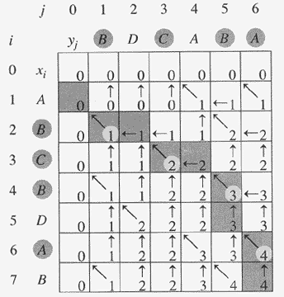
Another LCS Example

Slide 29
How to Find Actual LCS
So far, we have just found the length of LCS, but not LCS itself.
We can modify this algorithm to make it output an LCS of X and Y.
Each c[i, j] depends on c[i-1, j-1], or c[i-1, j] and c[i, j-1].
For each c[i, j] we can say how it was acquired.
2
2
For example, here
c[i, j] = c[i-1, j-1] +1 = 2+1=3
2
3

Slide 30

How to Find Actual LCS
Remember that
So we can start from c[m, n] and go backwards
Whenever c[i, j] = c[i-1, j-1]+1, remember x[i], because x[i] is a part of LCS
When i=0 or j=0 (i.e. we reached the beginning), output remembered letters in reverse order

Slide 31
Finding LCS: Example
j 0 1 2 3 4 5
i
y_{j}
B
D
C
A
G
0
x_{i}
0
0
0
0
0
0
A
1
0
0
0
0
1
1
2
B
0
1
1
1
1
2
3
C
0
1
1
2
2
2
4
G
3
0
1
1
2
2

Slide 32
Finding LCS: Example
j 0 1 2 3 4 5
i
y_{j}
B
D
C
A
G
0
x_{i}
0
0
0
0
0
0
A
1
0
0
0
0
1
1
2
B
0
1
1
1
1
2
3
C
0
1
1
2
2
2
4
G
3
0
1
1
2
2
LCS (reversed order):
G
C
B
LCS (straight order):
B C G

Slide 33
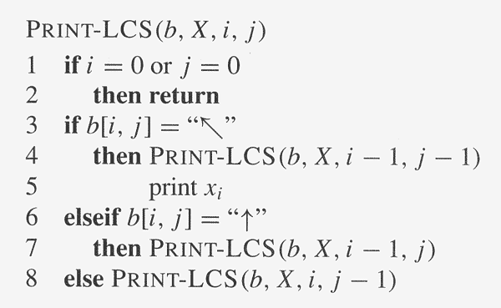
Finding LCS: Algorithm
Trace backwards from b[m, n]

